Slide 1
CISE-301: Numerical Methods
Topic 1:
Introduction to Numerical Methods and Taylor Series
Lectures 1-4:
CISE301_Topic1

Slide 2
Lecture 1
Introduction to Numerical Methods
What are NUMERICAL METHODS?
Why do we need them?
Topics covered in CISE301.
Reading Assignment: Pages 3-10 of textbook
CISE301_Topic1

Slide 3
Numerical Methods
Numerical Methods:
Algorithms that are used to obtain numerical solutions of a mathematical problem.
Why do we need them?
1. No analytical solution exists,
2. An analytical solution is difficult to obtain
or not practical.
CISE301_Topic1

Slide 4
What do we need?
Basic Needs in the Numerical Methods:
  Practical:
  Can be computed in a reasonable amount of time.
  Accurate:
    Good approximate to the true value,
    Information about the approximation error (Bounds, error order,… ).
CISE301_Topic1

Slide 5
Outlines of the Course
Taylor Theorem
Number Representation
Solution of nonlinear Equations
Interpolation
Numerical Differentiation
Numerical Integration
Solution of linear Equations
Least Squares curve fitting
Solution of ordinary differential equations
Solution of Partial differential equations
CISE301_Topic1

Slide 6
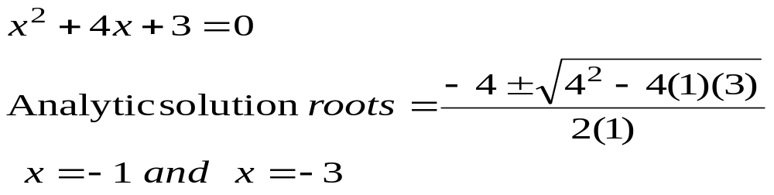
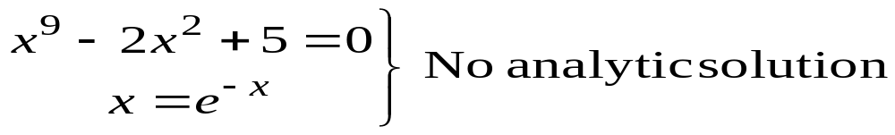
Solution of Nonlinear Equations
Some simple equations can be solved analytically:
Many other equations have no analytical solution:
CISE301_Topic1

Slide 7
Methods for Solving Nonlinear Equations
Bisection Method
Newton-Raphson Method
Secant Method
CISE301_Topic1

Slide 8
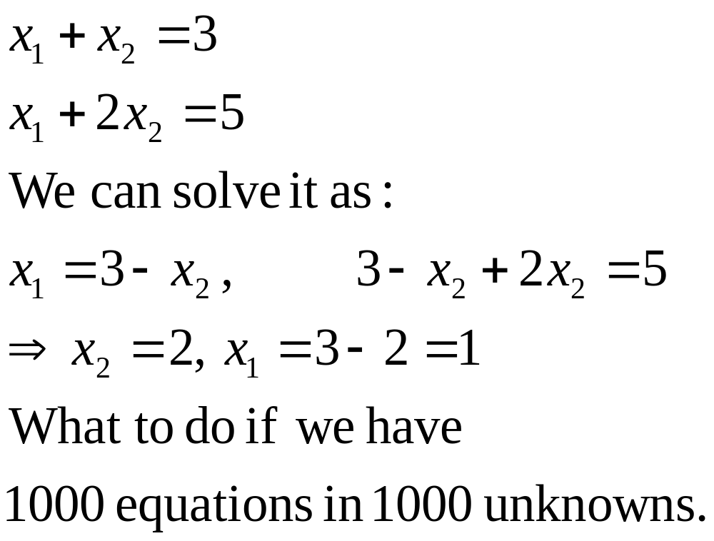
Solution of Systems of Linear Equations
CISE301_Topic1

Slide 9
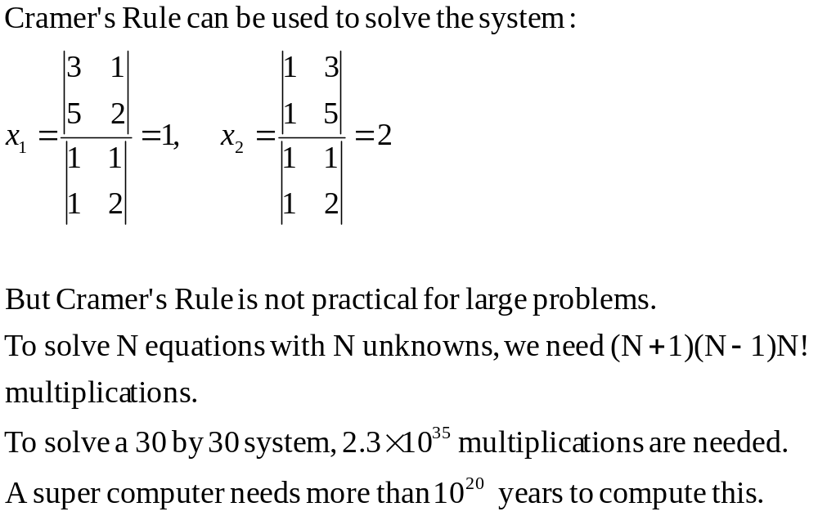
Cramer’s Rule is Not Practical
CISE301_Topic1

Slide 10
Methods for Solving Systems of Linear Equations
Naive Gaussian Elimination
Gaussian Elimination with Scaled Partial Pivoting
Algorithm for Tri-diagonal Equations
CISE301_Topic1

Slide 11
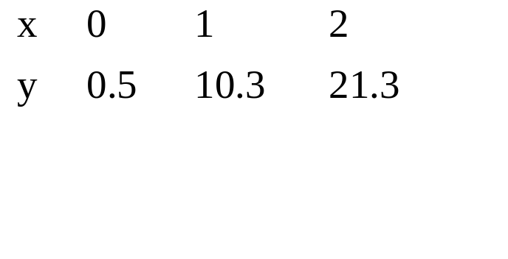
Curve Fitting
Given a set of data:
Select a curve that best fits the data. One choice is to find the curve so that the sum of the square of the error is minimized.
CISE301_Topic1

Slide 12

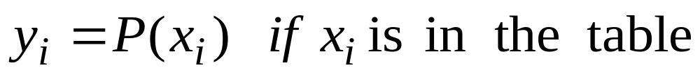
Interpolation
Given a set of data:
Find a polynomial P(x) whose graph passes through all tabulated points.
CISE301_Topic1

Slide 13
Methods for Curve Fitting
Least Squares
  Linear Regression
  Nonlinear Least Squares Problems
Interpolation
  Newton Polynomial Interpolation
  Lagrange Interpolation
CISE301_Topic1

Slide 14
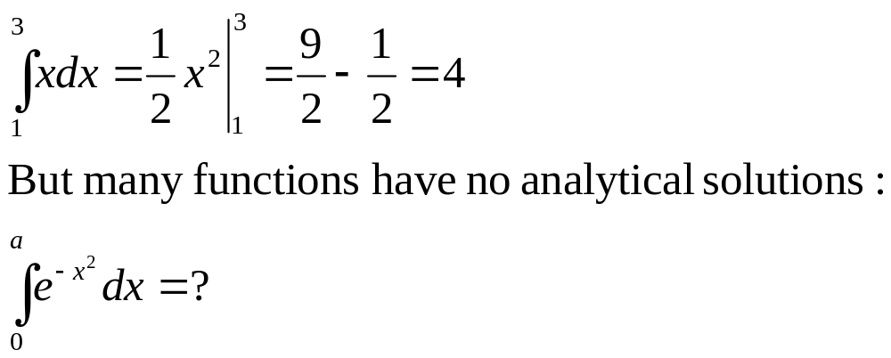
Integration
Some functions can be integrated analytically:
CISE301_Topic1

Slide 15
Methods for Numerical Integration
Upper and Lower Sums
Trapezoid Method
Romberg Method
Gauss Quadrature
CISE301_Topic1

Slide 16
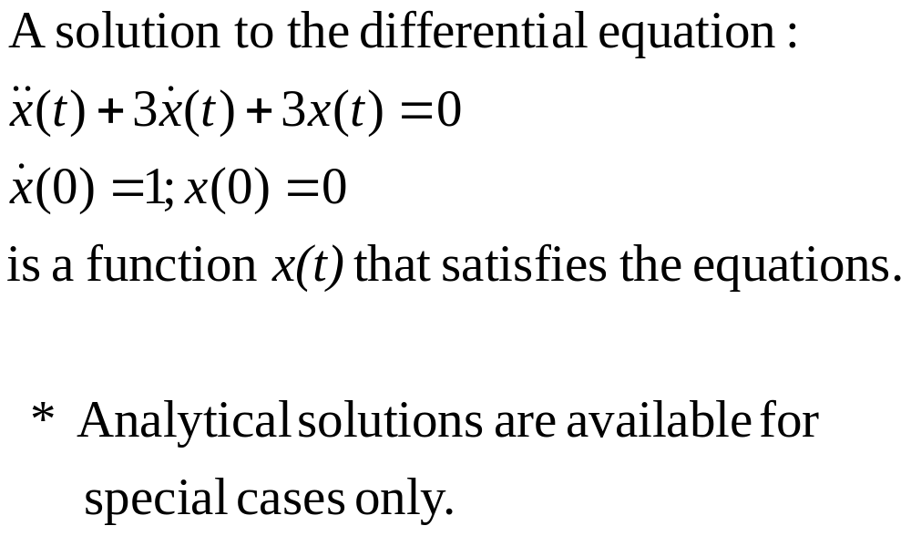
Solution of Ordinary Differential Equations
CISE301_Topic1

Slide 17
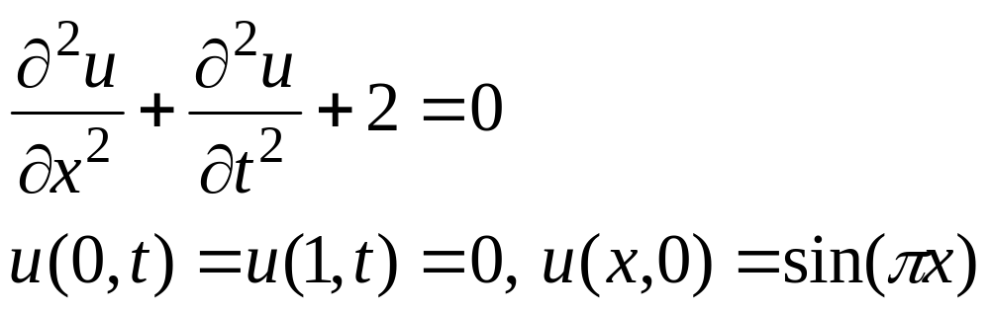
Solution of Partial Differential Equations
Partial Differential Equations are more difficult to solve than ordinary differential equations:
CISE301_Topic1

Slide 18
Summary
Numerical Methods:
Algorithms that are used to obtain numerical solution of a mathematical problem.
We need them when
No analytical solution exists or it is difficult to obtain it.
Topics Covered in the Course
Solution of Nonlinear Equations
Solution of Linear Equations
Curve Fitting
  Least Squares
  Interpolation
Numerical Integration
Numerical Differentiation
Solution of Ordinary Differential Equations
Solution of Partial Differential Equations
CISE301_Topic1

Slide 19
Lecture 2
Number Representation and Accuracy
Number Representation
Normalized Floating Point Representation
Significant Digits
Accuracy and Precision
Rounding and Chopping
Reading Assignment: Chapter 3
CISE301_Topic1

Slide 20
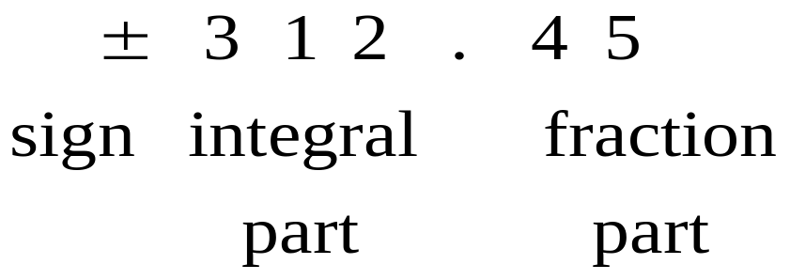
Representing Real Numbers
You are familiar with the decimal system:
Decimal System: Base = 10 , Digits (0,1,…,9)
Standard Representations:
CISE301_Topic1

Slide 21
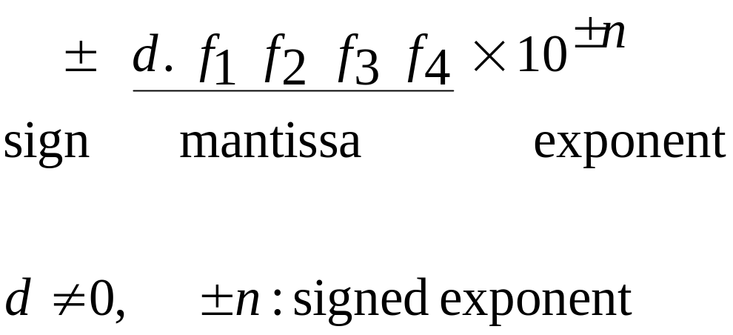
Normalized Floating Point Representation
Normalized Floating Point Representation:
Scientific Notation: Exactly one non-zero digit appears before decimal point.
Advantage: Efficient in representing very small or very large numbers.
CISE301_Topic1

Slide 22
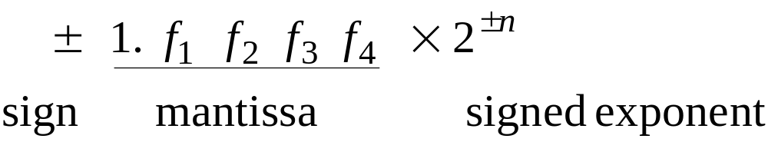
Binary System
Binary System: Base = 2, Digits {0,1}
CISE301_Topic1

Slide 23
Fact
Numbers that have a finite expansion in one numbering system may have an infinite expansion in another numbering system:
You can never represent 1.1 exactly in binary system.
CISE301_Topic1

Slide 24
IEEE 754 Floating-Point Standard
Single Precision (32-bit representation)
  1-bit Sign + 8-bit Exponent + 23-bit Fraction
Double Precision (64-bit representation)
  1-bit Sign + 11-bit Exponent + 52-bit Fraction
S
Exponent⁸
Fraction²³
S
Exponent¹¹
Fraction⁵²
(continued)
CISE301_Topic1

Slide 25
Significant Digits
Significant digits are those digits that can be used with confidence.
Single-Precision: 7 Significant Digits
  1.175494… × 10⁻³⁸ to 3.402823… × 10³⁸
Double-Precision: 15 Significant Digits
  2.2250738… × 10⁻³⁰⁸ to 1.7976931… × 10³⁰⁸
CISE301_Topic1

Slide 26
Remarks
Numbers that can be exactly represented are called machine numbers.
Difference between machine numbers is not uniform
Sum of machine numbers is not necessarily a machine number
CISE301_Topic1

Slide 27
Calculator Example
Suppose you want to compute:
3.578 * 2.139
using a calculator with two-digit fractions
3.57
*
2.13
=
7.60
True answer:
7.653342
CISE301_Topic1

Slide 28
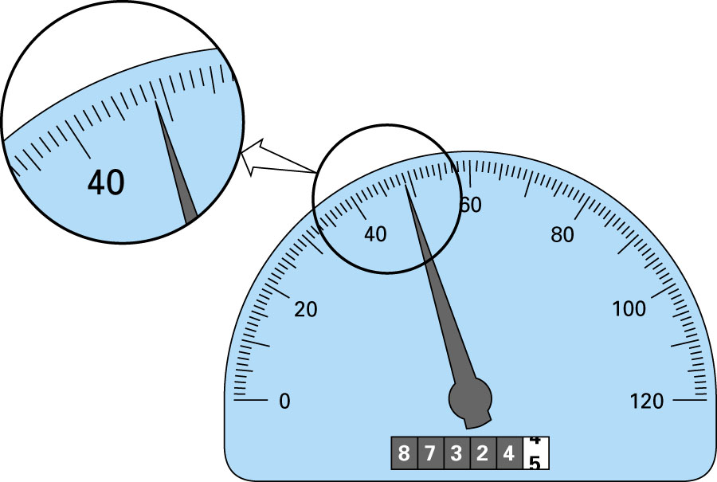
48.9
Significant Digits - Example
CISE301_Topic1

Slide 29
Accuracy and Precision
Accuracy is related to the closeness to the true value.
Precision is related to the closeness to other estimated values.
CISE301_Topic1

Slide 30
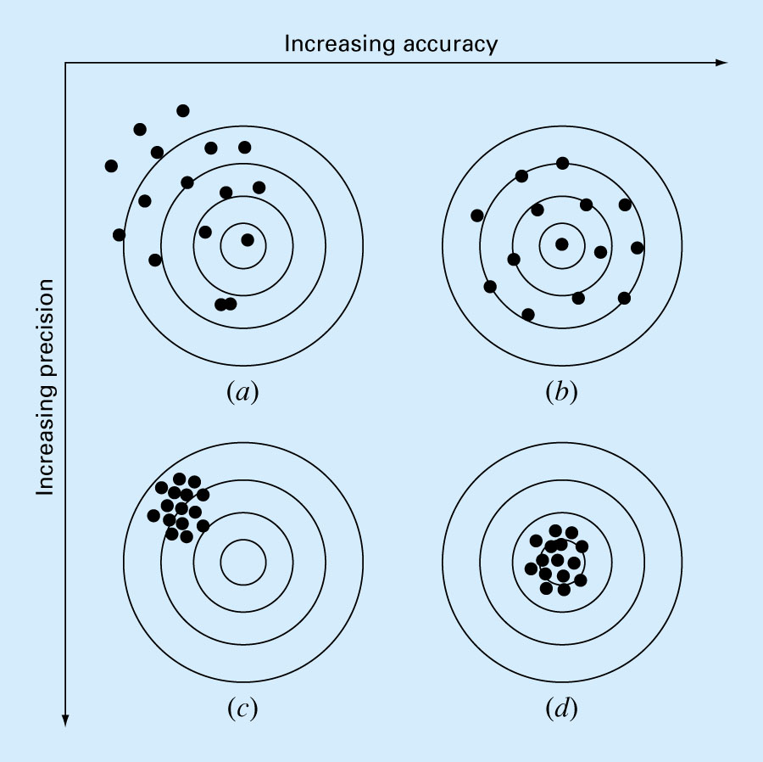
CISE301_Topic1

Slide 31
Rounding and Chopping
Rounding: Replace the number by the nearest
machine number.
Chopping: Throw all extra digits.
CISE301_Topic1

Slide 32
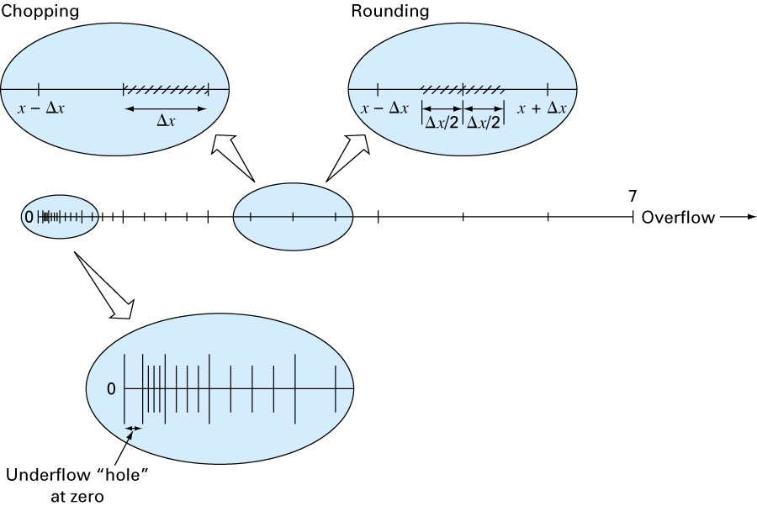
Rounding and Chopping
CISE301_Topic1

Slide 33
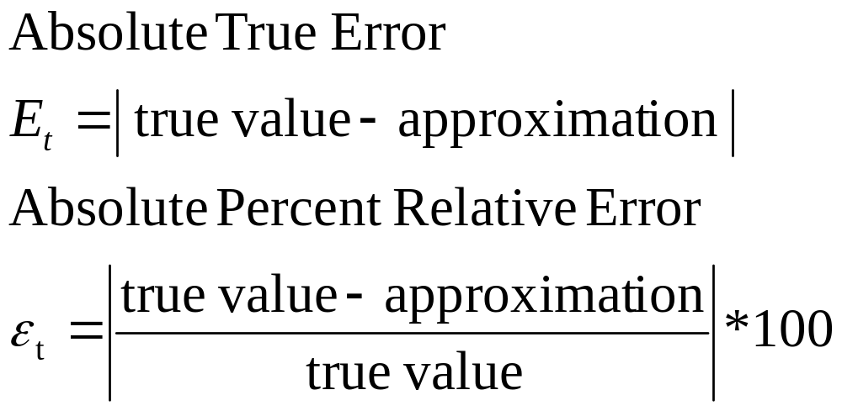
Error Definitions – True Error
Can be computed if the true value is known:
CISE301_Topic1

Slide 34
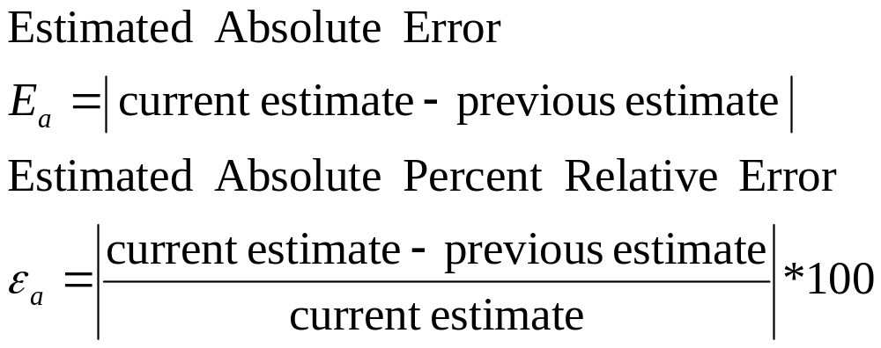
Error Definitions – Estimated Error
When the true value is not known:
CISE301_Topic1

Slide 35
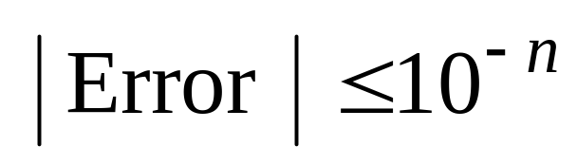
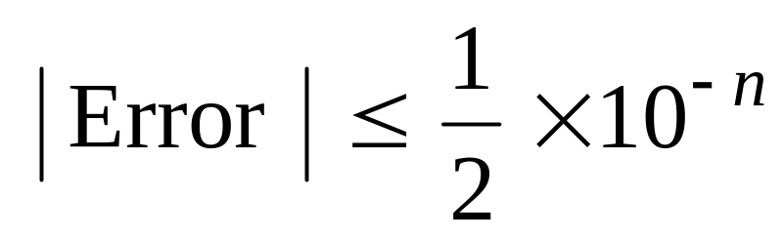
Notation
We say that the estimate is correct to n decimal digits if:
We say that the estimate is correct to n decimal digits rounded if:
CISE301_Topic1

Slide 36
Summary
Number Representation
Numbers that have a finite expansion in one numbering system may have an infinite expansion in another numbering system.
Normalized Floating Point Representation
  Efficient in representing very small or very large numbers,
  Difference between machine numbers is not uniform,
  Representation error depends on the number of bits used in the mantissa.
CISE301_Topic1

Slide 37
Lectures 3-4
Taylor Theorem
Motivation
Taylor Theorem
Examples
Reading assignment: Chapter 4
CISE301_Topic1

Slide 38
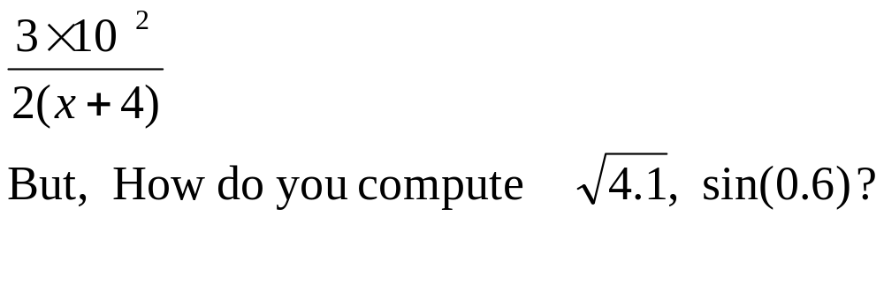
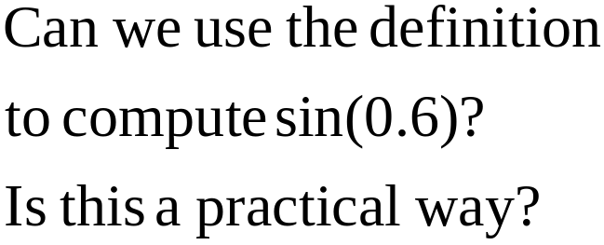
Motivation
We can easily compute expressions like:
b
a
0.6
CISE301_Topic1

Slide 39
Remark
In this course, all angles are assumed to be in radian unless you are told otherwise.
CISE301_Topic1

Slide 40
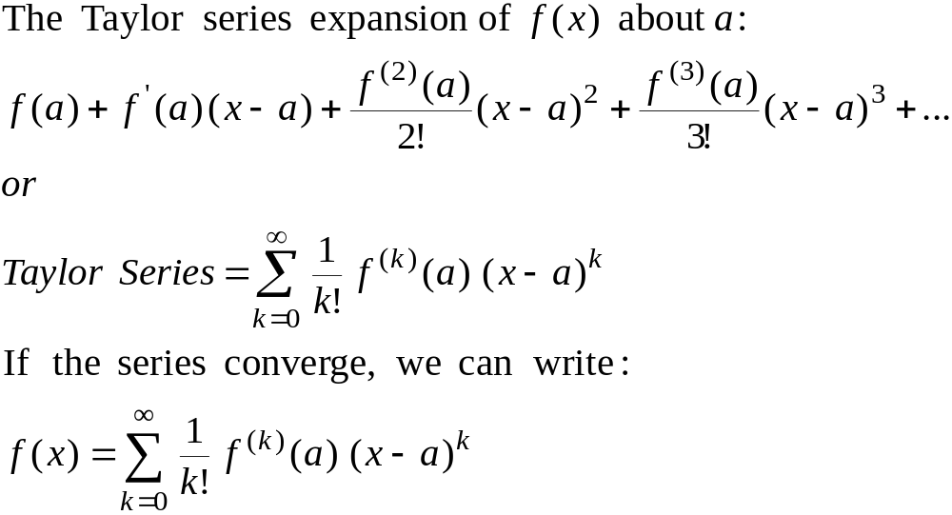
Taylor Series
CISE301_Topic1

Slide 41
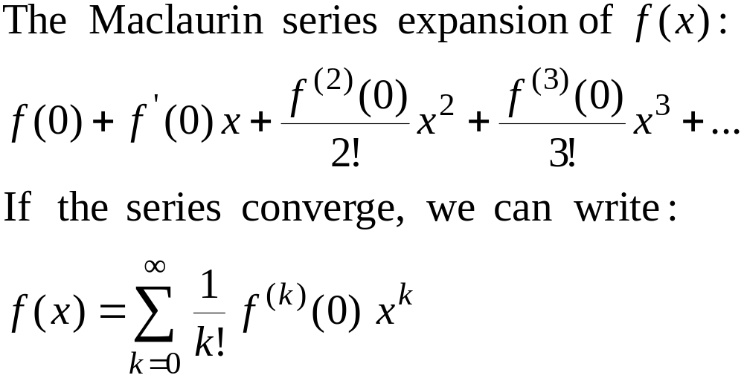
Maclaurin Series
Maclaurin series is a special case of Taylor series with the center of expansion a = 0.
CISE301_Topic1

Slide 42
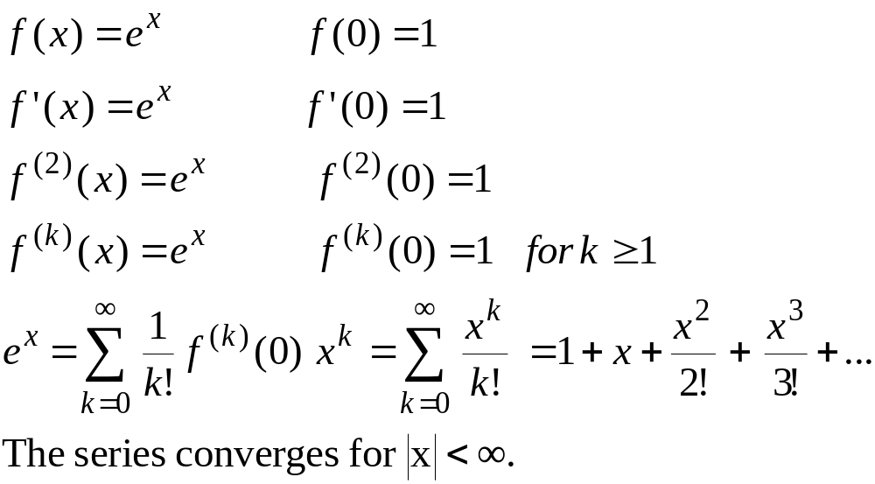
Maclaurin Series – Example 1
CISE301_Topic1

Slide 43
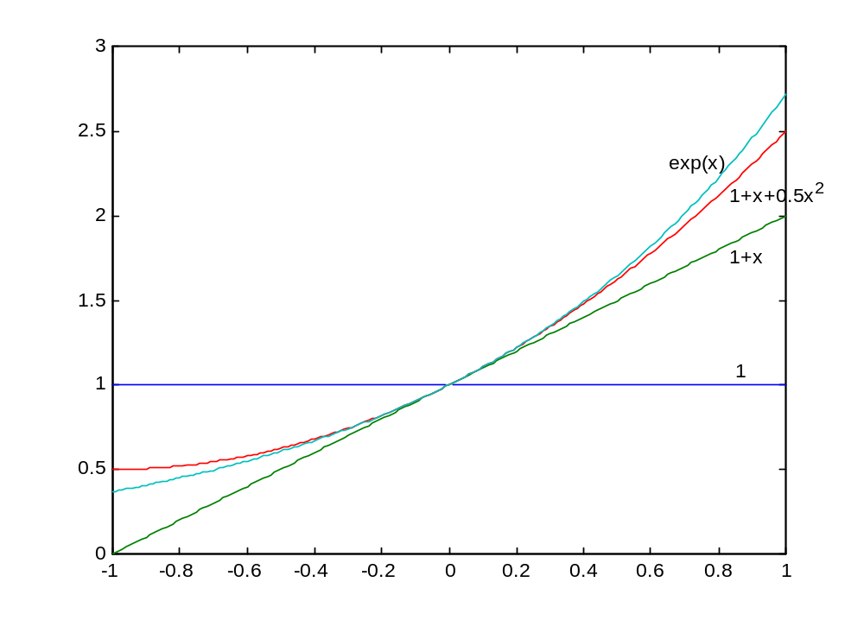
Taylor Series
Example 1
CISE301_Topic1

Slide 44
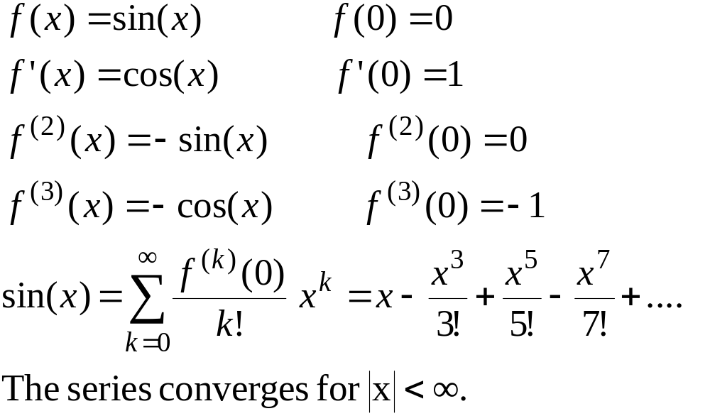
Maclaurin Series – Example 2
CISE301_Topic1

Slide 45
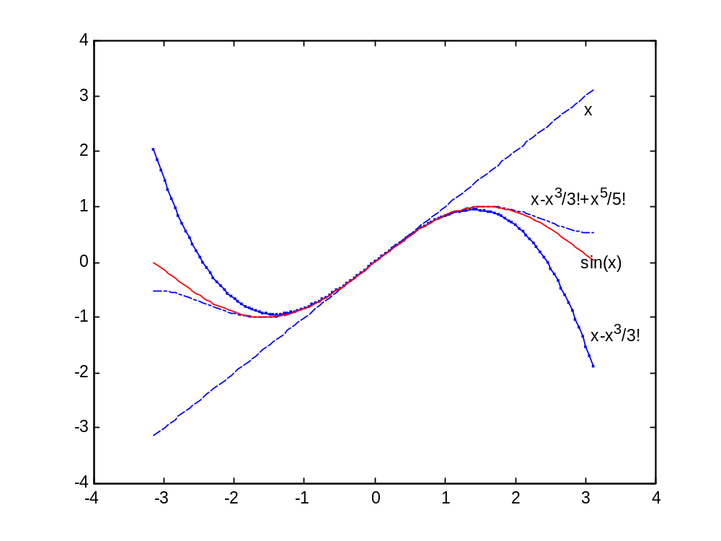
CISE301_Topic1

Slide 46
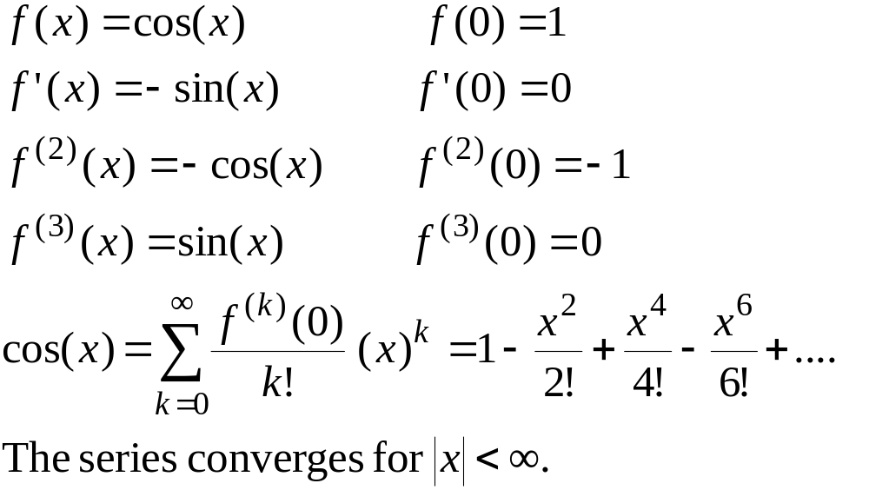
Maclaurin Series – Example 3
CISE301_Topic1

Slide 47
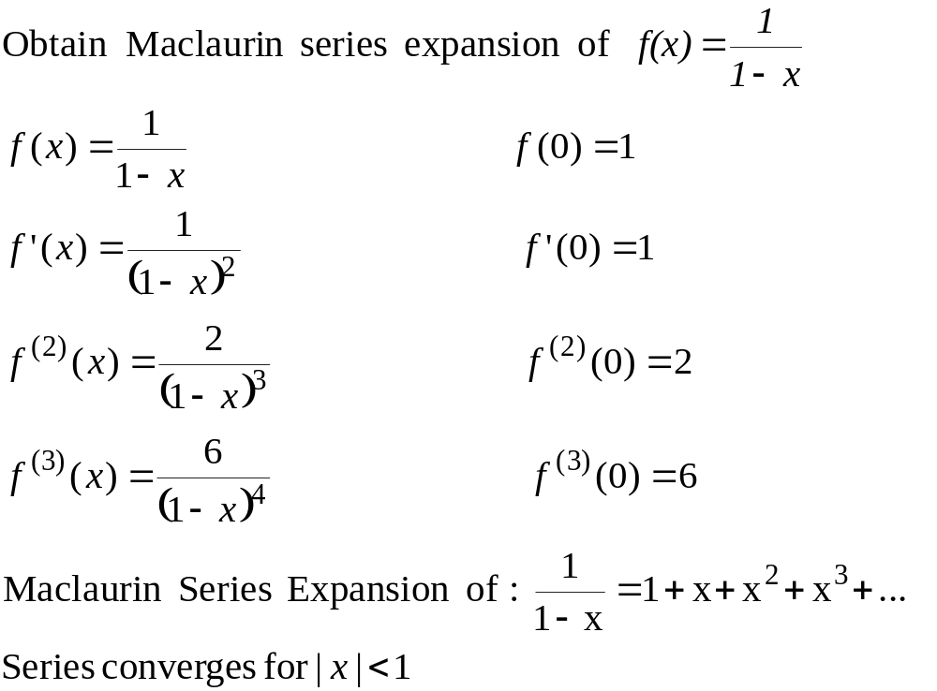
Maclaurin Series – Example 4
CISE301_Topic1

Slide 48
Example 4 - Remarks
Can we apply the series for x≥1??
How many terms are needed to get a good approximation???
These questions will be answered using Taylor’s Theorem.
CISE301_Topic1

Slide 49
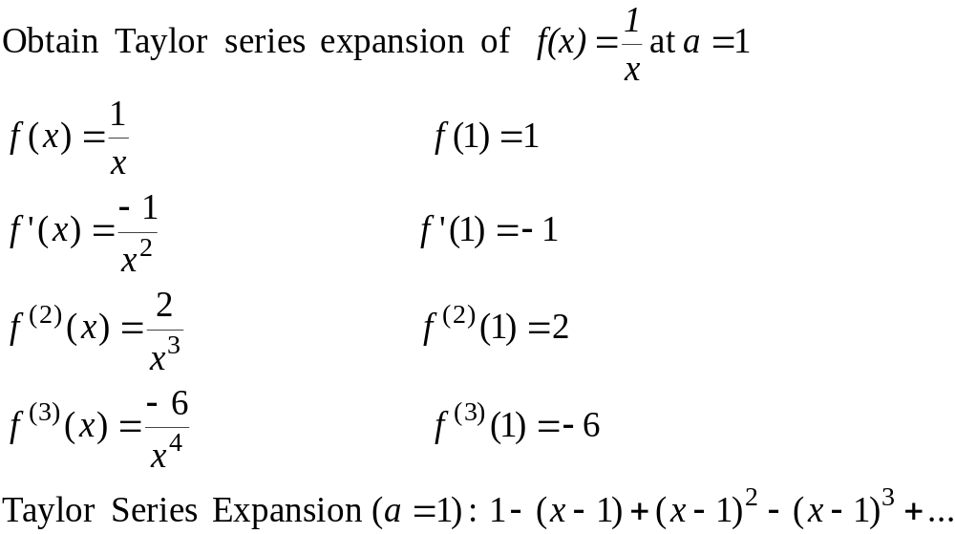
Taylor Series – Example 5
CISE301_Topic1

Slide 50
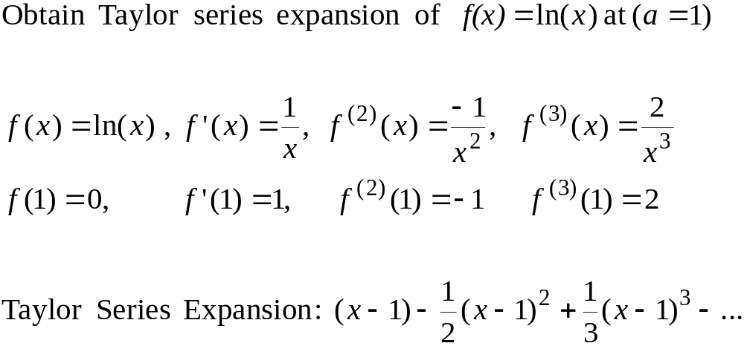
Taylor Series – Example 6
CISE301_Topic1

Slide 51
Convergence of Taylor Series
The Taylor series converges fast (few terms are needed) when x is near the point of expansion. If |x-a| is large then more terms are needed to get a good approximation.
CISE301_Topic1

Slide 52
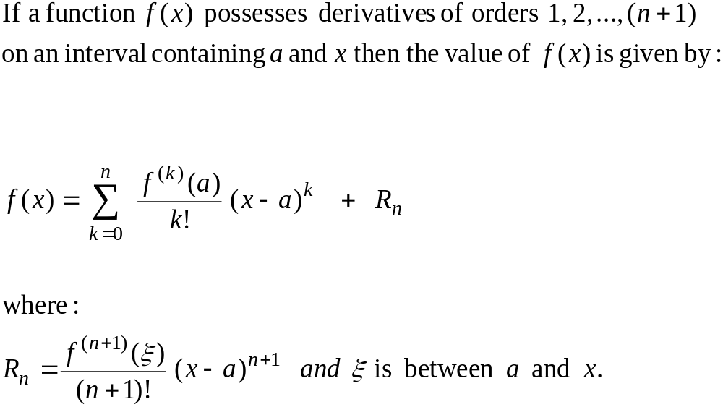
Taylor’s Theorem
(n+1) terms Truncated Taylor Series
Remainder
CISE301_Topic1

Slide 53
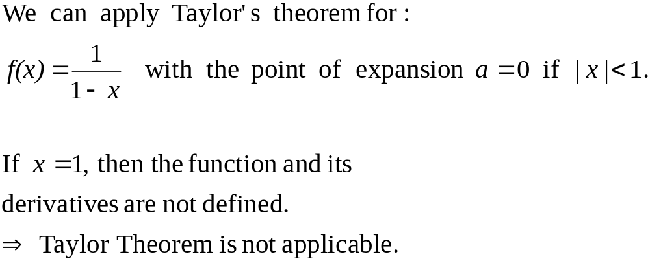
Taylor’s Theorem
CISE301_Topic1

Slide 54
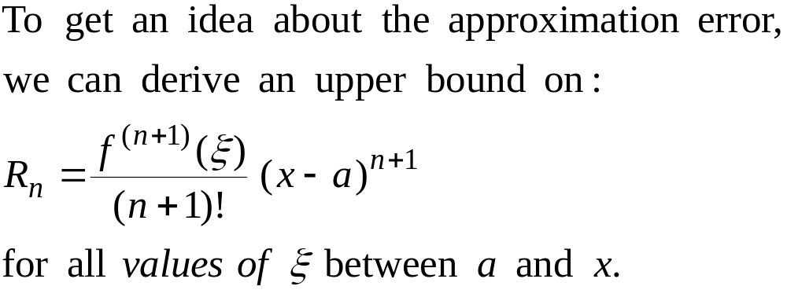
Error Term
CISE301_Topic1

Slide 55
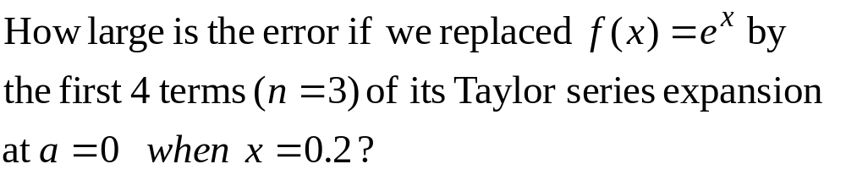
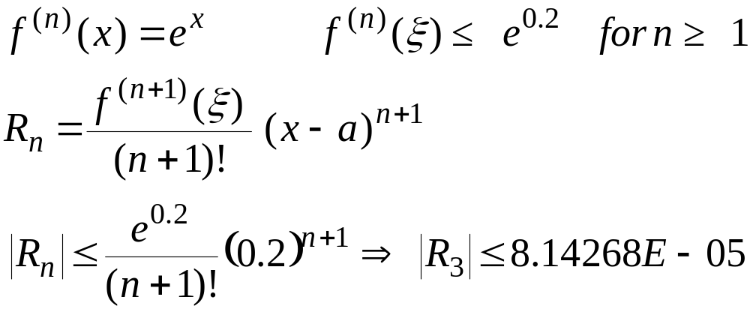
Error Term - Example
CISE301_Topic1

Slide 56
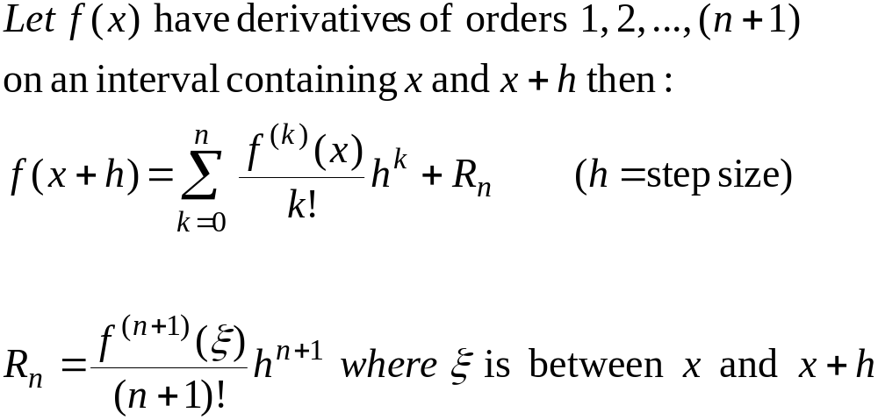
Alternative form of Taylor’s Theorem
CISE301_Topic1

Slide 57
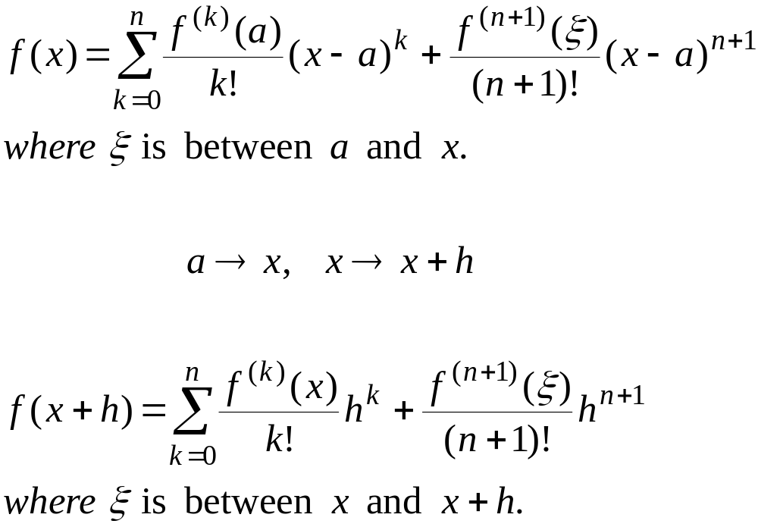
Taylor’s Theorem – Alternative forms
CISE301_Topic1

Slide 58
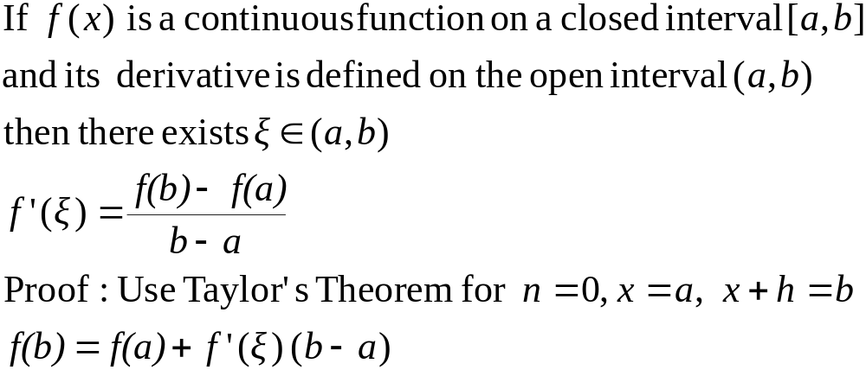
Mean Value Theorem
CISE301_Topic1

Slide 59
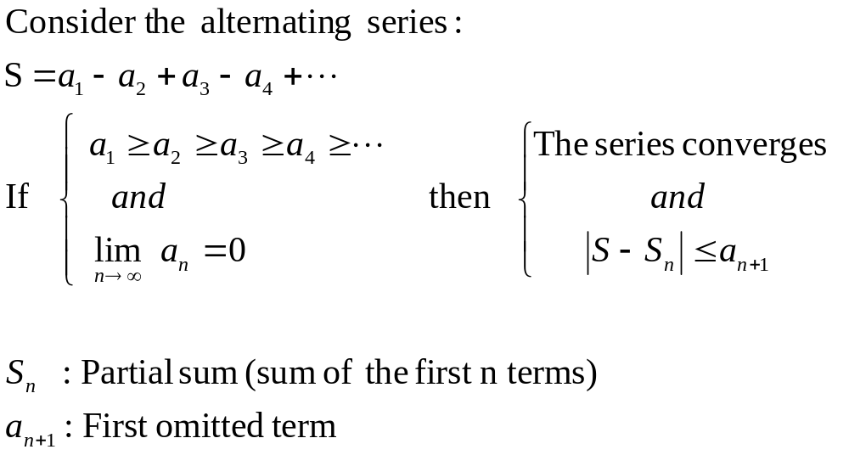
Alternating Series Theorem
CISE301_Topic1

Slide 60
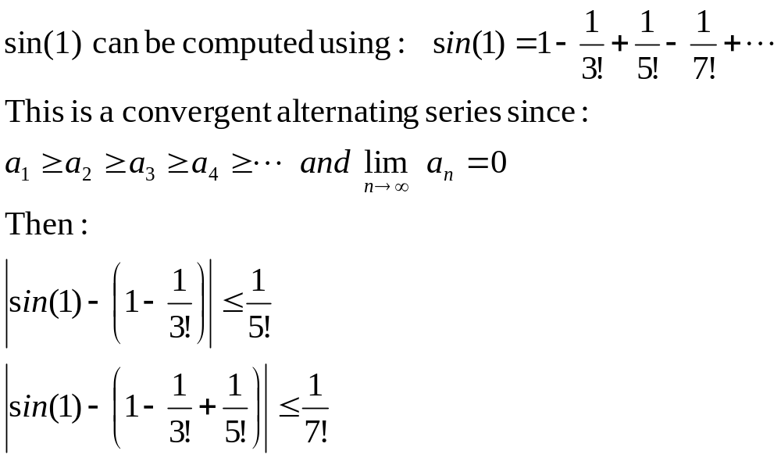
Alternating Series – Example
CISE301_Topic1

Slide 61
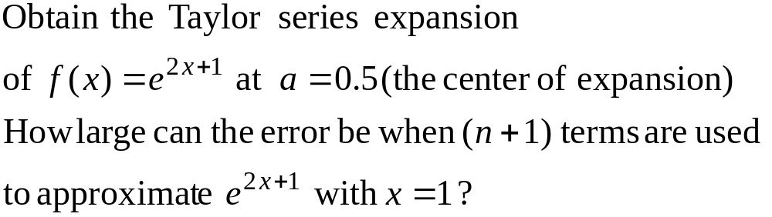
Example 7
CISE301_Topic1

Slide 62
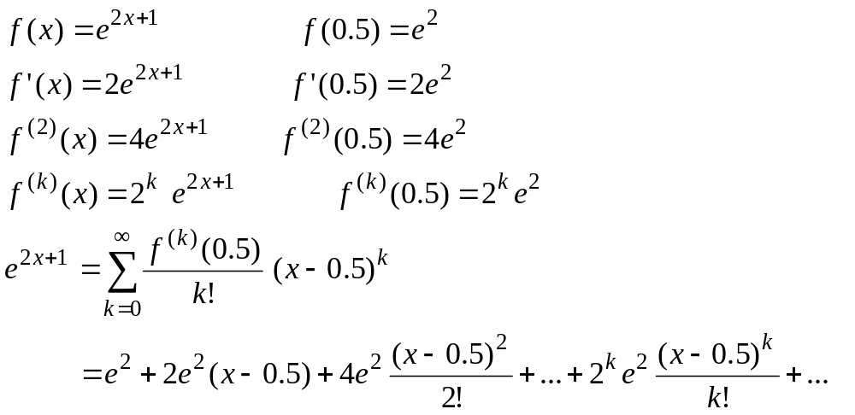
Example 7 – Taylor Series
CISE301_Topic1

Slide 63
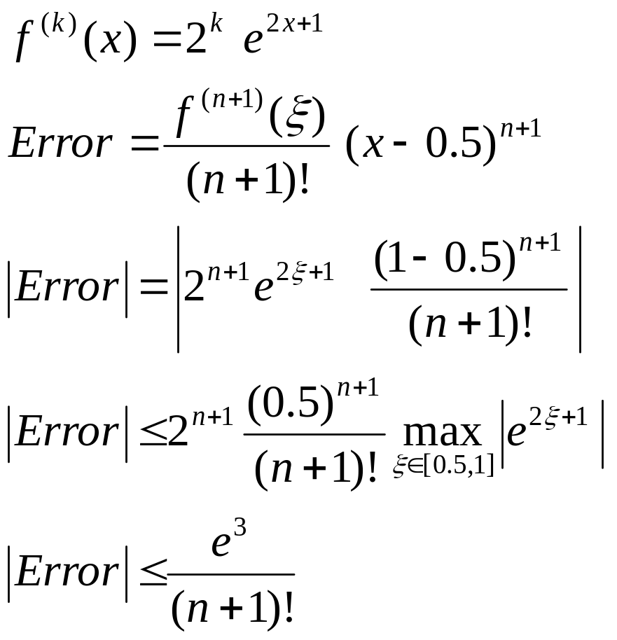
Example 7 – Error Term
CISE301_Topic1

